Slide 1
Digital Portfolio
STUDENT NAME: MIRUTHIVKA B
REGISTER NO AND NMID: 2428C0486 AND
5274DD0906CDDE1B4F04CA8E57E460AD
DEPARTMENT: Bsc AI&ML
COLLEGE: KPR College of Arts & Science,Bharathiyar Un

Slide 2
PROJECT TITLE
Medical Student Internship Portfolio

Slide 3


AGENDA
Problem Statement
Project Overview
End Users
Tools and Technologies
Portfolio design and Layout
Features and Functionality
Results and Screenshots
Conclusion
Github Link
3/21/2024 Annual Review

Slide 4

PROBLEM STATEMENT
As medical students, we often find ourselves strong in theory but lacking real clinical experience.It's one thing to read about diseases in textbooks—but another to see them firsthand.Many internships lack structure, leaving students unsure of what they should be learning.This internship was designed to bridge that gap and give us a meaningful hands-on experience.

Slide 5

PROJECT OVERVIEW
This internship took us through multiple hospital departments, from medicine and surgery to pediatrics.
We were placed under the guidance of experienced doctors and mentors. Every day brought something new—ward rounds, patient interactions, procedures, and more.
The focus was on helping us apply what we've learned in the classroom to real-life situations.

Slide 6

WHO ARE THE END USERS?
Students
Mentors
Hospitals
Patients

Slide 7

TOOLS AND TECHNIQUES
We used a mix of digital and hands-on tools throughout the internship.
Electronic medical records helped us understand case histories and treatments.
We tracked our daily learning using digital logbooks and mobile apps.
Simulation labs gave us a safe space to practice before facing real patients.

Slide 8
POTFOLIO DESIGN AND LAYOUT
We built personal internship portfolios to document everything we experienced.
Each section included patient cases, procedures observed, and mentor feedback.
Photos, charts, and reflections made it both informative and visually engaging.
The portfolio also served as proof of our progress and learning journey.

Slide 9
FEATURES AND FUNCTIONALITY
Our daily routine included case discussions, ward rounds, and supervised procedures.
We were encouraged to ask questions, take initiative, and work as part of the healthcare team.
Weekly feedback sessions helped us improve in real-time.
Everything was designed to help us grow both clinically and professionally.

Slide 10

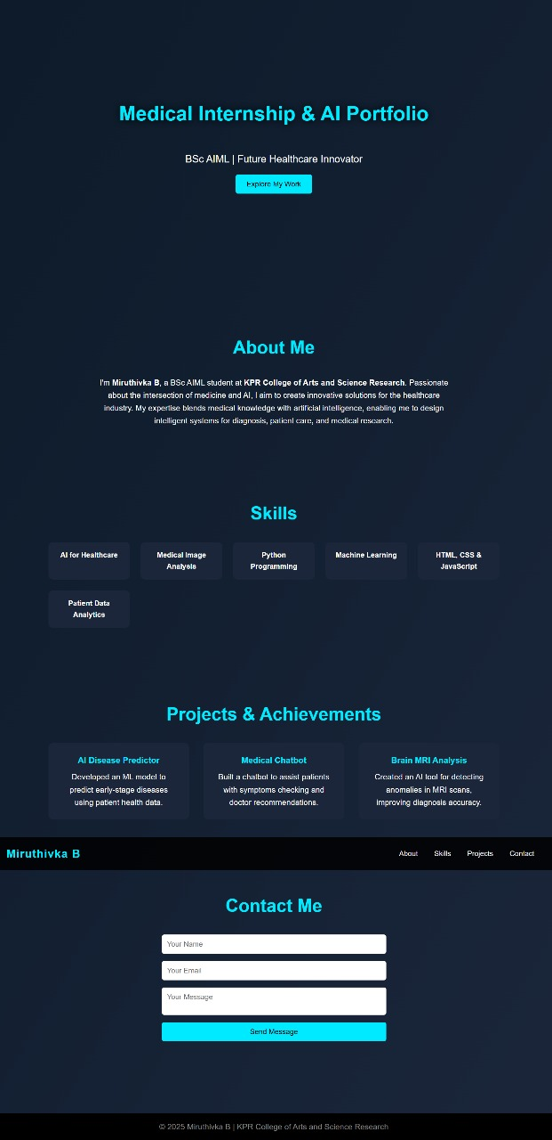
RESULTS AND SCREENSHOTS
By the end of the internship, we felt a real improvement in our confidence and skills.
We’ve included screenshots of our logbooks, case records, and portfolio highlights.
Mentor feedback showed how far we’ve come in critical thinking and patient care.
These results prove just how effective a structured internship can be.
3/21/2024 Annual Review

Slide 11
CONCLUSION
Overall, this internship has been one of the most valuable parts of our medical training.
It gave us a glimpse into real-world medicine and helped us grow as future doctors.
We learned not just how to treat diseases, but how to care for people.
We hope more students get the chance to experience something like this.

Slide 12
Git hub Link:
portfolio Repository :
https://github.com/miruthivka29/medical-portfolio-.git

